Slide 1


Mathematics for Machine Learning
02
PART I · FOUNDATIONS
CHAPTER 2 · WEEK 1
Machine Learning — From Hypotheses to Decisions
LECTURER
Dr. Mustafa Hameed
THE ISLAMIA UNIVERSITY OF BAHAWALPUR
Bahawalpur, Pakistan
Department of Information Technology · BSIT · Fall 2026
Notes:
Chapter 2: Mathematics for Machine Learning. Part 1 — Foundations. Week 1: What machine learning is; its mathematics. Handout pages 11–19.

Slide 2

Where this chapter sits
THE COURSE
PART I
PART II
PART III
PART IV
PART V
PART VI
1
2
3
4
5
6
7
8
9
10
11
12
13
14
15
16
17
18
19
20
21
22
Mathematics for Machine Learning
BUILDS ON
USED LATER IN
Ch 1 What Machine Learning Is
Ch 3 The Machine Learning Workflow and Toolkit
Ch 5 Linear Regression
Ch 6 Logistic Regression
Ch 8 Measuring Classifier Performance
Ch 9 Decision Tree Learning
Machine Learning · Chapter 2 · Mathematics for Machine Learning
Handout p. 11 2
Notes:
Place the chapter. Before you start: School algebra, and the probability you used in Artificial Intelligence. Chapter 1 for the idea of a model with weights w0, …, wd. Appendix B collects every formula in this chapter on one page.

Slide 3

What you will be able to do
LEARNING OUTCOMES
By the end of this chapter you will be able to:
1
Compute dot products, norms and distances, and write a linear model as a dot product.
2
Explain what the product Xw computes for a whole dataset at once.
3
Differentiate a simple loss function and perform gradient descent steps by hand, including choosing a learning rate.
4
Apply Bayes’ theorem to a base-rate problem.
5
Estimate a parameter by maximum likelihood, and compute the entropy of a distribution.
Machine Learning · Chapter 2 · Mathematics for Machine Learning
Handout p. 11 3
Notes:
Read these out: they are the chapter's contract with the room. Each click adds one.

Slide 4

Vocabulary for this chapter
KEY TERMS
vector
dot product
norm
Euclidean distance
cosine similarity
matrix
transpose
derivative
partial derivative
gradient
chain rule
gradient descent
learning rate
conditional probability
Bayes’ theorem
expectation
variance
Gaussian
likelihood
maximum likelihood
entropy
Each term is defined where it first matters — not here.
Machine Learning · Chapter 2 · Mathematics for Machine Learning
Handout p. 11 4
Notes:
Do not define these now; they arrive one at a time. This slide is for the students' notes. Terms: vector; dot product; norm; Euclidean distance; cosine similarity; matrix; transpose; derivative; partial derivative; gradient; chain rule; gradient descent; learning rate; conditional probability; Bayes’ theorem; expectation; variance; Gaussian; likelihood; maximum likelihood; entropy.

Slide 5

In this chapter
IN THIS CHAPTER
2.1
Four Kinds of Mathematics, Four Jobs
p. 11 ›
2.2
Vectors and the Dot Product
p. 12 ›
2.3
Matrices: A Whole Dataset at Once
p. 12 ›
2.4
Derivatives and Gradients
p. 13 ›
2.5
Gradient Descent
p. 13 ›
2.6
Probability
p. 14 ›
2.7
Expectation, Variance and the Gaussian
p. 15 ›
2.8
Maximum Likelihood
p. 15 ›
2.9
Information and Entropy
p. 16 ›
Machine Learning · Chapter 2 · Mathematics for Machine Learning
Handout pp. 11–19 5
Notes:
The route through the chapter. Each row is a link: click it to jump to that section in the slide show.

Slide 6

Four Kinds of Mathematics, Four Jobs
AT A GLANCE
Mathematics | Its job | Where it appears
Linear algebra | Represent examples and models | Every model: an example is a vector, a dataset is a matrix, a linear model is a dot product (Chs 5, 6, 12, 13, 16)
Calculus | Optimise: find the weights that minimise a loss | Gradient descent in Chs 5, 6 and 13; backpropagation is the chain rule
Probability | Reason under uncertainty | Naive Bayes (Ch 10), EM (Ch 17), HMMs (Ch 18), every stochastic environment in Part V
Information theory | Measure surprise | Decision-tree splits (Ch 9) and the cross-entropy loss (Ch 6)
Machine Learning · Chapter 2 · Mathematics for Machine Learning
§2.1 · Handout p. 11 6
Notes:
Machine learning uses four pieces of mathematics, and each does one job. It is worth knowing which is which, because when a formula appears later you will know what it is for before you know what it says.

Slide 7
Vectors and the Dot Product
SECTION 2 OF 9
2.2
2.1 Four Kinds of Mathematics, Four Jobs
2.2 Vectors and the Dot Product
2.3 Matrices: A Whole Dataset at Once
2.4 Derivatives and Gradients
2.5 Gradient Descent
2.6 Probability
2.7 Expectation, Variance and the Gaussian
2.8 Maximum Likelihood
Machine Learning · Chapter 2
Handout §2.2 7
Notes:
Pause. Name the question this section answers.

Slide 8


Vector, Dot Product and Norm
DEFINITION
A vector x = (x₁, …, x_{d}) is an ordered list of d numbers — in this course, usually the features of one example.
The dot product of two vectors of the same length multiplies them element by element and adds up:
Machine Learning · Chapter 2 · Mathematics for Machine Learning
§2.2 · Handout p. 12 8
Notes:
Read the box aloud, then ask for an example from the room before moving on.

Slide 9

One Student as a Vector
WORKED EXAMPLE
A student has attendance 0.9, quiz average 0.6 and 4 logins per week: x = (0.9, 0.6, 4). A model has weights w = (2, 3, 0.25) and bias b = −3.
Score: w·x + b = (2)(0.9) + (3)(0.6) + (0.25)(4) − 3 = 1.8 + 1.8 + 1.0 − 3 = 1.6.
Distance to a second student z = (0.5, 0.4, 1):
Look at where the distance came from. Of the 9.2 under the root, 9 is logins. Attendance and quiz marks — arguably the more important differences — contribute almost nothing, simply because they are measured on a scale of 0 to 1 and logins are not. Any method built on distance (Chapter 11, Chapter 15) needs the features put on a common scale first (Chapter 3).
Machine Learning · Chapter 2 · Mathematics for Machine Learning
§2.2 · Handout p. 12 9
Notes:
The dot product is the most important operation in this course. A linear model — linear regression, logistic regression, a perceptron, an SVM — computes one dot product and adds a bias: ŷ = w·x + b. Each weight says how much its feature pushes the prediction up or down.
Each click adds one step of the working. Ask for the next number before you reveal it.

Slide 10

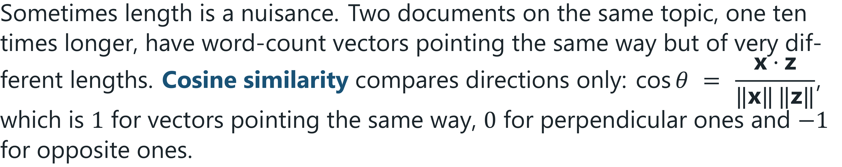
Cosine Similarity: Direction Without Length
CONCEPT
Machine Learning · Chapter 2 · Mathematics for Machine Learning
§2.2 · Handout p. 12 10
Notes:
Read the box aloud, then ask for an example from the room before moving on.

Slide 11
Matrices: A Whole Dataset at Once
SECTION 3 OF 9
2.3
2.1 Four Kinds of Mathematics, Four Jobs
2.2 Vectors and the Dot Product
2.3 Matrices: A Whole Dataset at Once
2.4 Derivatives and Gradients
2.5 Gradient Descent
2.6 Probability
2.7 Expectation, Variance and the Gaussian
2.8 Maximum Likelihood
Machine Learning · Chapter 2
Handout §2.3 11
Notes:
Pause. Name the question this section answers.

Slide 12
Data Matrix and Matrix–Vector Product
DEFINITION
Stack n examples as the rows of a matrix X with n rows and d columns. Then Xw is a vector of n numbers: row i of the result is the dot product of example i with w. The transpose X swaps rows and columns.
Machine Learning · Chapter 2 · Mathematics for Machine Learning
§2.3 · Handout p. 12 12
Notes:
Read the box aloud, then ask for an example from the room before moving on.

Slide 13
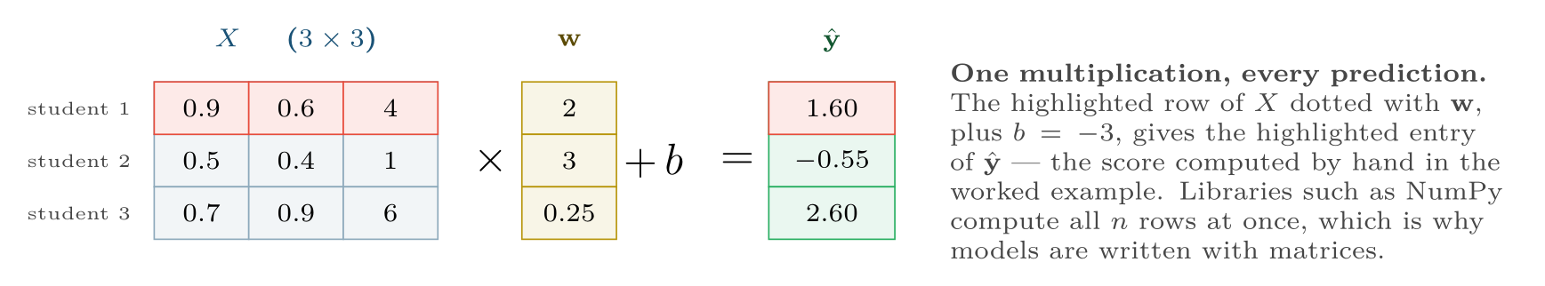
A matrix–vector product scores every example in one operation
FIGURE 2.1
Each row of X is one example; each entry of ŷ is that row’s dot product with the weights.
Machine Learning · Chapter 2 · Mathematics for Machine Learning
§2.3 · Handout p. 12 13
Notes:
Figure 2.1 (handout p. 13): A matrix–vector product scores every example in one operation. Each row of X is one example; each entry of ŷ is that row’s dot product with the weights.

Slide 14
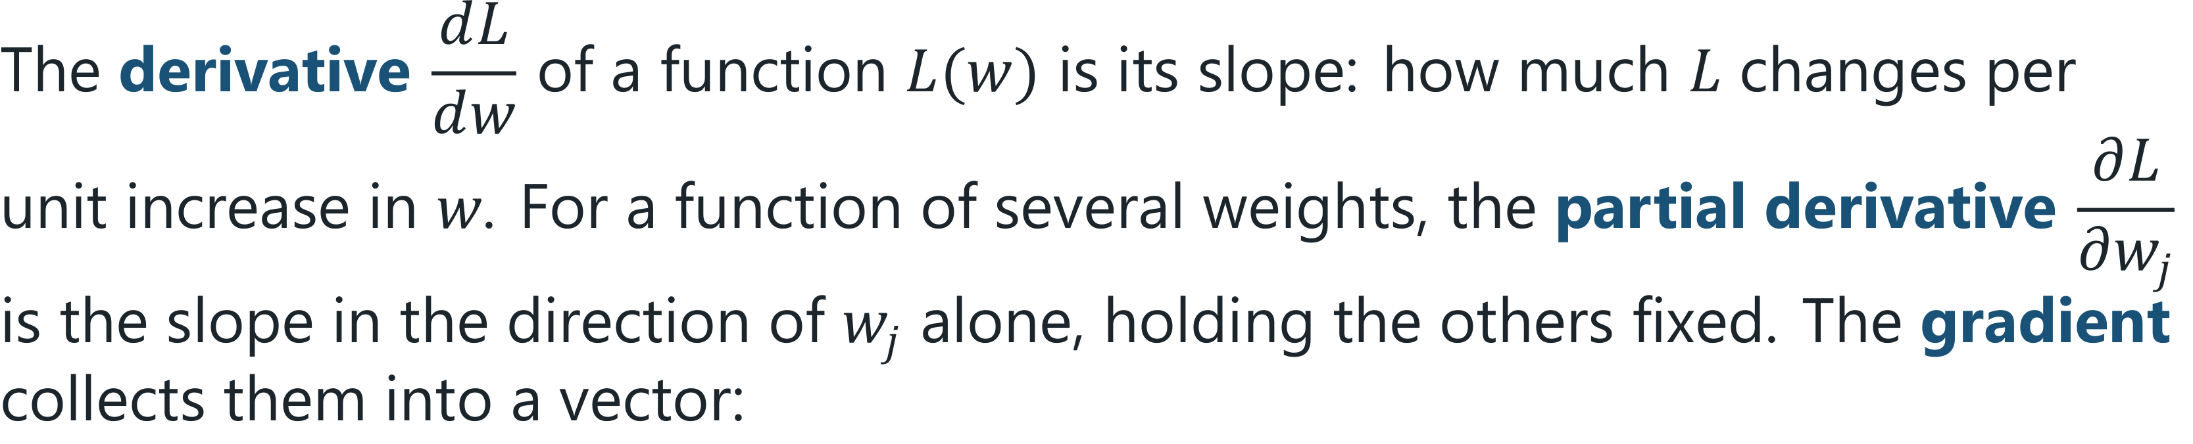
Derivative, Partial Derivative, Gradient
DEFINITION
The gradient points in the direction in which L increases fastest.
Machine Learning · Chapter 2 · Mathematics for Machine Learning
§2.4 · Handout p. 13 14
Notes:
You will meet one more matrix operation, in Chapter 5: the inverse A−1 of a square matrix, which undoes multiplication by A the way dividing by 3 undoes multiplying by 3. You will never compute one by hand; NumPy does.

Slide 15
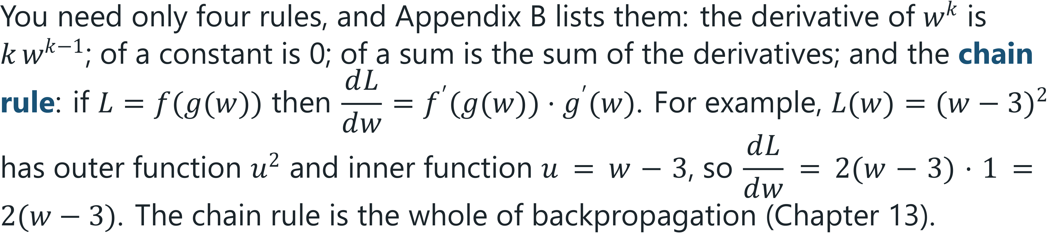
Derivatives and Gradients
IN BRIEF
Machine Learning · Chapter 2 · Mathematics for Machine Learning
§2.4 · Handout p. 13 15
Notes:
Read the box aloud, then ask for an example from the room before moving on.

Slide 16
Gradient Descent
SECTION 5 OF 9
2.5
2.1 Four Kinds of Mathematics, Four Jobs
2.2 Vectors and the Dot Product
2.3 Matrices: A Whole Dataset at Once
2.4 Derivatives and Gradients
2.5 Gradient Descent
2.6 Probability
2.7 Expectation, Variance and the Gaussian
2.8 Maximum Likelihood
Machine Learning · Chapter 2
Handout §2.5 16
Notes:
Pause. Name the question this section answers.

Slide 17
Gradient Descent
DEFINITION
Start from any weights. Repeatedly take a small step against the gradient:
The learning rate α > 0 sets the step size. Stop when the loss stops decreasing.
Machine Learning · Chapter 2 · Mathematics for Machine Learning
§2.5 · Handout p. 13 17
Notes:
Training a model means finding weights that make a loss L(w) small. For most models there is no formula for the best weights, so we walk downhill instead.

Slide 18
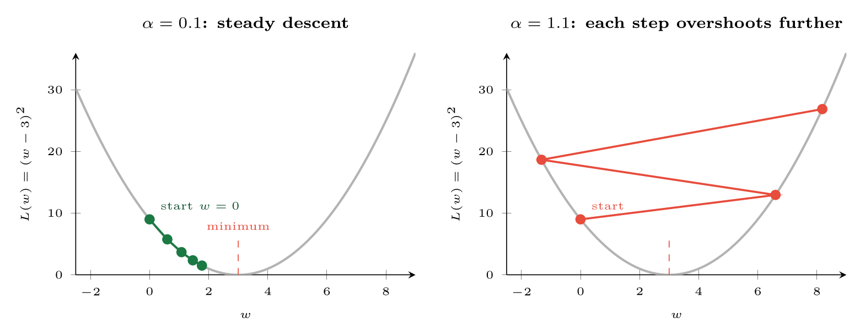
Gradient descent on L(w)=(w−3)2 from w=0
FIGURE 2.2
With a small learning rate each step closes a fixed fraction of the gap; with one that is too large, each step jumps past the minimum by more than the last, and the weights diverge.
Machine Learning · Chapter 2 · Mathematics for Machine Learning
§2.5 · Handout p. 13 18
Notes:
Figure 2.2 (handout p. 14): Gradient descent on L(w)=(w−3)2 from w=0. With a small learning rate each step closes a fixed fraction of the gap; with one that is too large, each step jumps past the minimum by more than the last, and the weights diverge.

Slide 19
Four Steps of Gradient Descent
WORKED EXAMPLE
Minimise L(w) = (w−3)² starting from w = 0 with α = 0.1. The gradient is L′(w) = 2(w−3).
Step | w | L′(w) = 2(w−3) | w − 0.1 L′(w)
0 | 0 | −6 | 0 + 0.6 = 0.6
1 | 0.6 | −4.8 | 0.6 + 0.48 = 1.08
2 | 1.08 | −3.84 | 1.08 + 0.384 = 1.464
3 | 1.464 | −3.072 | 1.464 + 0.3072 = 1.7712
The pattern. The gap to the minimum goes 3 → 2.4 → 1.92 → 1.536 → 1.2288: every step multiplies it by 1 − 2α = 0.8. So
• α = 0.1: the gap shrinks by 20% a step — steady.
• α = 0.5: the factor is 0, so one step lands exactly on 3.
Machine Learning · Chapter 2 · Mathematics for Machine Learning
§2.5 · Handout p. 13 19
Notes:
Each click adds one step of the working. Ask for the next number before you reveal it.

Slide 20
Four Steps of Gradient Descent (continued)
WORKED EXAMPLE
• α = 1.1: the factor is −1.2 — the weight flips to the far side and lands further away each time: 0 → 6.6 → −1.32 → 8.18. It diverges (Figure 2.2, right).
Real losses are not this simple, and the right α is found by trying several (Chapter 7), but the three behaviours — slow, just right, divergent — are exactly the ones you will see.
Machine Learning · Chapter 2 · Mathematics for Machine Learning
§2.5 · Handout p. 13 20
Notes:
Each click adds one step of the working. Ask for the next number before you reveal it.

Slide 21
Probability
SECTION 6 OF 9
2.6
2.1 Four Kinds of Mathematics, Four Jobs
2.2 Vectors and the Dot Product
2.3 Matrices: A Whole Dataset at Once
2.4 Derivatives and Gradients
2.5 Gradient Descent
2.6 Probability
2.7 Expectation, Variance and the Gaussian
2.8 Maximum Likelihood
Machine Learning · Chapter 2
Handout §2.6 21
Notes:
Pause. Name the question this section answers.

Slide 22
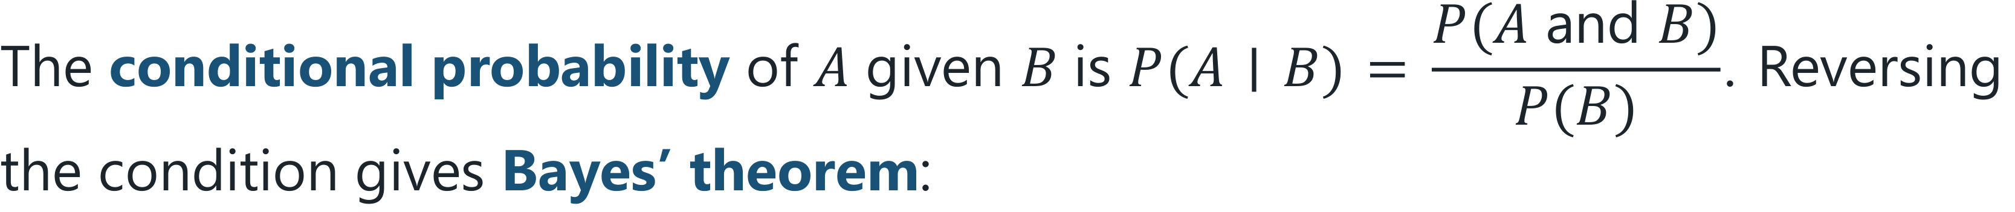
Conditional Probability and Bayes’ Theorem
DEFINITION
P(A) is the prior, P(B ∣ A) the likelihood and P(A ∣ B) the posterior. Two events are independent if P(A and B) = P(A) P(B).
Machine Learning · Chapter 2 · Mathematics for Machine Learning
§2.6 · Handout p. 14 22
Notes:
Read the box aloud, then ask for an example from the room before moving on.

Slide 23
An Alarm You Should Not Panic About
WORKED EXAMPLE
An intrusion detector catches 99% of attacks and raises a false alarm on 1% of benign connections. One connection in a thousand is an attack. An alarm sounds. What is the probability of an attack?
Let A = attack, B = alarm. P(A) = 0.001, P(B ∣ A) = 0.99, P(B ∣ notA) = 0.01.
Only 9% of alarms are attacks, from a detector that is “99% accurate”. There are so many more benign connections that their 1% of false alarms outnumbers the real attacks ten to one. This is the base-rate effect, and it is why Chapter 8 insists on precision rather than accuracy. Naive Bayes (Chapter 10) is this calculation, done for every class.
Machine Learning · Chapter 2 · Mathematics for Machine Learning
§2.6 · Handout p. 14 23
Notes:
Each click adds one step of the working. Ask for the next number before you reveal it.

Slide 24

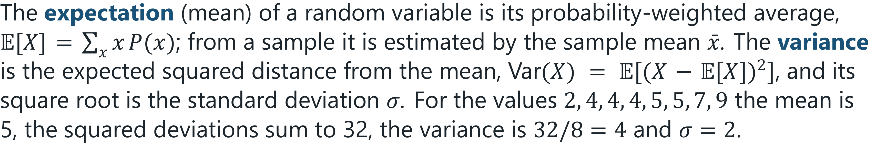
Expectation, Variance and the Gaussian
KEY IDEA
The Gaussian (normal) distribution with mean μ and variance σ² has density
It appears in Gaussian naive Bayes (Chapter 10) and Gaussian mixtures (Chapter 17), and whenever a model assumes that its errors are small, symmetric and unsurprising.
Machine Learning · Chapter 2 · Mathematics for Machine Learning
§2.7 · Handout p. 15 24
Notes:
Say this in your own words first; the slide is the handout's wording.

Slide 25
Maximum Likelihood
SECTION 8 OF 9
2.8
2.1 Four Kinds of Mathematics, Four Jobs
2.2 Vectors and the Dot Product
2.3 Matrices: A Whole Dataset at Once
2.4 Derivatives and Gradients
2.5 Gradient Descent
2.6 Probability
2.7 Expectation, Variance and the Gaussian
2.8 Maximum Likelihood
Machine Learning · Chapter 2
Handout §2.8 25
Notes:
Pause. Name the question this section answers.

Slide 26
Likelihood and Maximum Likelihood Estimation
DEFINITION
For data D and parameters θ, the likelihood L(θ) = P(D ∣ θ) is the probability of the data under those parameters, read as a function of θ. The maximum likelihood estimate θ̂_{ML} is the θ that maximises it. In practice one maximises the log-likelihood log L(θ) instead: the logarithm turns products into sums and has the same maximum.
Machine Learning · Chapter 2 · Mathematics for Machine Learning
§2.8 · Handout p. 15 26
Notes:
Most learning algorithms can be read as answering one question: which parameters make the observed data most probable?

Slide 27
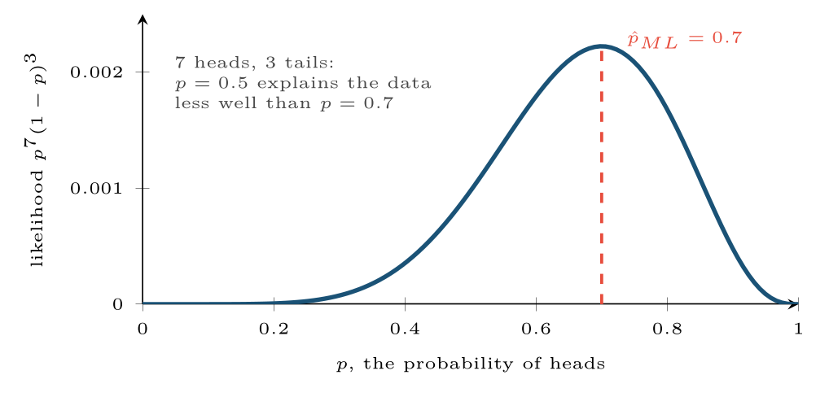
The likelihood of seven heads in ten tosses, as a function of the coin’s bias
FIGURE 2.3
It is largest at p=0.7 — the observed proportion, which is what maximum likelihood gives for any coin.
Machine Learning · Chapter 2 · Mathematics for Machine Learning
§2.8 · Handout p. 15 27
Notes:
Figure 2.3 (handout p. 16): The likelihood of seven heads in ten tosses, as a function of the coin’s bias. It is largest at p=0.7 — the observed proportion, which is what maximum likelihood gives for any coin.

Slide 28
The Maximum Likelihood Coin
WORKED EXAMPLE
A coin gives 7 heads in 10 tosses. The likelihood of that sequence is L(p) = p⁷(1−p)³, and the log-likelihood is (p) = 7ln p + 3ln(1−p). Set its derivative to zero:
The answer is what intuition says — the observed fraction — but the method is general: the same argument gives the least-squares line of Chapter 5 and the cross-entropy loss of Chapter 6, and the EM algorithm of Chapter 17 is a way of doing it when some data is missing.
Machine Learning · Chapter 2 · Mathematics for Machine Learning
§2.8 · Handout p. 15 28
Notes:
Each click adds one step of the working. Ask for the next number before you reveal it.

Slide 29

Maximum Likelihood Trusts Small Samples Too Much
WATCH OUT
One toss, one head: p̂_{ML} = 1, a coin that can never land tails. A word that never appeared in the training e-mails gets probability zero, and a single zero makes a whole product zero. Chapter 10 fixes this with Laplace smoothing: add one imaginary observation of every outcome.
Machine Learning · Chapter 2 · Mathematics for Machine Learning
§2.8 · Handout p. 15 29
Notes:
Read the box aloud, then ask for an example from the room before moving on.

Slide 30
Information and Entropy
SECTION 9 OF 9
2.9
2.1 Four Kinds of Mathematics, Four Jobs
2.2 Vectors and the Dot Product
2.3 Matrices: A Whole Dataset at Once
2.4 Derivatives and Gradients
2.5 Gradient Descent
2.6 Probability
2.7 Expectation, Variance and the Gaussian
2.8 Maximum Likelihood
Machine Learning · Chapter 2
Handout §2.9 30
Notes:
Pause. Name the question this section answers.

Slide 31

Entropy
DEFINITION
The entropy of a distribution (p₁, …, p_{k}) measures its uncertainty, in bits:
It is 0 when one outcome is certain, and largest — log₂ k bits — when all k outcomes are equally likely.
Machine Learning · Chapter 2 · Mathematics for Machine Learning
§2.9 · Handout p. 16 31
Notes:
Read the box aloud, then ask for an example from the room before moving on.

Slide 32
Entropy of a Set of Examples
WORKED EXAMPLE
Fourteen days, of which 9 were suitable for tennis and 5 were not:
A 7–7 split would give exactly 1 bit; a 14–0 split, 0 bits. A decision tree (Chapter 9) chooses the question that lowers this number the most — that is, the question whose answer leaves the least uncertainty behind.
Machine Learning · Chapter 2 · Mathematics for Machine Learning
§2.9 · Handout p. 16 32
Notes:
Each click adds one step of the working. Ask for the next number before you reveal it.

Slide 33

Common pitfalls
COMMON PITFALLS
✕
Forgetting the minus sign in gradient descent. w + α∇ L climbs the loss. The update subtracts.
✕
Reading a diverging loss as “needs more steps”. If the loss grows, the learning rate is too large; more steps make it worse.
✕
Confusing P(A ∣ B) with P(B ∣ A). “The detector catches 99% of attacks” is P(alarm ∣ attack); the analyst wants P(attack ∣ alarm), which was 9%.
✕
Computing distances on unscaled features. The feature with the largest units decides the answer.
✕
Multiplying many small probabilities. The product underflows to zero on a computer; add log-probabilities instead.
Machine Learning · Chapter 2 · Mathematics for Machine Learning
§2.9 · Handout p. 16 33
Notes:
For each pitfall, ask who has seen it happen. One real story beats five bullets.

Slide 34





Four lenses: The Mathematics at Work
FOUR LENSES
LEARNING ANALYTICS
PROJECT MANAGEMENT
A student is a vector of engagement features, and “students like this one” means “students at a small distance” — once attendance, marks and logins have been put on the same scale.
Fitting an effort model to past stories is gradient descent on the mean squared error of the estimates.
INTERNET OF THINGS
CYBERSECURITY
Sensor noise is usually close to Gaussian, so a reading three standard deviations from its recent mean has a likelihood below one in three hundred under “normal operation”.
The base-rate calculation is the most important piece of arithmetic in security analytics.
Machine Learning · Chapter 2 · Mathematics for Machine Learning
Handout p. 19 34
Notes:
The same method, four domains. Each of the next four slides opens one lens in full.

Slide 35

Learning Analytics: The Mathematics at Work
FOUR LENSES
LEARNING ANALYTICS
Project Management
A student is a vector of engagement features, and “students like this one” means “students at a small distance” — once attendance, marks and logins have been put on the same scale. Without that, the student who logs in most is automatically the most different from everyone.
Internet of Things
Cybersecurity
Machine Learning · Chapter 2 · Mathematics for Machine Learning
Handout p. 19 35
Notes:
Learning Analytics. A student is a vector of engagement features, and “students like this one” means “students at a small distance” — once attendance, marks and logins have been put on the same scale. Without that, the student who logs in most is automatically the most different from everyone.

Slide 36

Project Management: The Mathematics at Work
FOUR LENSES
PROJECT MANAGEMENT
Learning Analytics
Fitting an effort model to past stories is gradient descent on the mean squared error of the estimates. With forty completed stories the loss surface is bumpy and the learning rate matters: too large and the fitted hours-per-point swings wildly from one run to the next.
Internet of Things
Cybersecurity
Machine Learning · Chapter 2 · Mathematics for Machine Learning
Handout p. 19 36
Notes:
Project Management. Fitting an effort model to past stories is gradient descent on the mean squared error of the estimates. With forty completed stories the loss surface is bumpy and the learning rate matters: too large and the fitted hours-per-point swings wildly from one run to the next.

Slide 37

Internet of Things: The Mathematics at Work
FOUR LENSES
INTERNET OF THINGS
Learning Analytics
Sensor noise is usually close to Gaussian, so a reading three standard deviations from its recent mean has a likelihood below one in three hundred under “normal operation”. That is the simplest anomaly detector there is, and it is a likelihood calculation.
Project Management
Cybersecurity
Machine Learning · Chapter 2 · Mathematics for Machine Learning
Handout p. 19 37
Notes:
Internet of Things. Sensor noise is usually close to Gaussian, so a reading three standard deviations from its recent mean has a likelihood below one in three hundred under “normal operation”. That is the simplest anomaly detector there is, and it is a likelihood calculation.

Slide 38

Cybersecurity: The Mathematics at Work
FOUR LENSES
CYBERSECURITY
Learning Analytics
The base-rate calculation is the most important piece of arithmetic in security analytics. Before deploying any detector, multiply its false-positive rate by the daily volume of benign events: that number of alerts, not the detection rate, decides whether the analysts will trust it.
Project Management
Internet of Things
Machine Learning · Chapter 2 · Mathematics for Machine Learning
Handout p. 19 38
Notes:
Cybersecurity. The base-rate calculation is the most important piece of arithmetic in security analytics. Before deploying any detector, multiply its false-positive rate by the daily volume of benign events: that number of alerts, not the detection rate, decides whether the analysts will trust it.

Slide 39

Try it yourself: The Chapter in NumPy
TRY IT YOURSELF
WHAT YOU WILL DO
1. Vectors and the dot product
2. A whole dataset at once
3. Gradient descent on L(w) = (w - 3)^2
4. Bayes by simulation: how many alarms are real?
5. Entropy
THIS WEEK'S LAB
WHAT YOU WILL RUN
RUNNABLE COPY
Week 1: A rule against a learned model; the chapter in NumPy
1 listing, 37 lines of Python
code/ch02_chapter_numpy.py
Machine Learning · Chapter 2 · Mathematics for Machine Learning
§2.9 · Handout p. 16 39
Notes:
Say what the room will have at the end of the lab, then let them start. Circulate rather than lecture.

Slide 40
The Chapter in NumPy
LAB · STEP 1 OF 5
Vectors and the dot product
Python · code/ch02_chapter_numpy.py
2
3
4
5
6
7
8
9
import numpy as np
# --- vectors and the dot product -----------------------------------------
x = np.array([0.9, 0.6, 4.0])
w = np.array([2.0, 3.0, 0.25])
print("score w.x + b :", round(w @ x - 3, 2)) # 1.6
z = np.array([0.5, 0.4, 1.0])
print("distance :", round(np.linalg.norm(x - z), 2)) # 3.03
Machine Learning · Chapter 2 · Mathematics for Machine Learning
§2.9 · Handout p. 16 40
Notes:
Step 1: Vectors and the dot product. Read the code aloud; ask what each line would print before running it.

Slide 41
The Chapter in NumPy
LAB · STEP 2 OF 5
A whole dataset at once
Python · code/ch02_chapter_numpy.py
11
12
13
# --- a whole dataset at once ---------------------------------------------
X = np.array([[0.9, 0.6, 4], [0.5, 0.4, 1], [0.7, 0.9, 6]])
print("X w + b :", X @ w - 3) # [1.6 -0.55 2.6]
Machine Learning · Chapter 2 · Mathematics for Machine Learning
§2.9 · Handout p. 16 41
Notes:
Step 2: A whole dataset at once. Read the code aloud; ask what each line would print before running it.

Slide 42
The Chapter in NumPy
LAB · STEP 3 OF 5
Gradient descent on L(w) = (w - 3)^2
Python · code/ch02_chapter_numpy.py
15
16
17
18
19
20
21
22
23
# --- gradient descent on L(w) = (w - 3)^2 --------------------------------
for alpha in (0.1, 0.5, 1.1):
wt = 0.0
path = [wt]
for step in range(4):
grad = 2 * (wt - 3)
wt = wt - alpha * grad
path.append(round(wt, 3))
print(f"alpha={alpha}: {path}")
Machine Learning · Chapter 2 · Mathematics for Machine Learning
§2.9 · Handout p. 16 42
Notes:
Step 3: Gradient descent on L(w) = (w - 3)^2. Read the code aloud; ask what each line would print before running it.

Slide 43
The Chapter in NumPy
LAB · STEP 4 OF 5
Bayes by simulation: how many alarms are real?
Python · code/ch02_chapter_numpy.py
25
26
27
28
29
30
# --- Bayes by simulation: how many alarms are real? ----------------------
rng = np.random.default_rng(0)
n = 1_000_000
attack = rng.random(n) < 0.001
alarm = np.where(attack, rng.random(n) < 0.99, rng.random(n) < 0.01)
print("P(attack | alarm), simulated:", attack[alarm].mean()) # about 0.09
Machine Learning · Chapter 2 · Mathematics for Machine Learning
§2.9 · Handout p. 16 43
Notes:
Step 4: Bayes by simulation: how many alarms are real?. Read the code aloud; ask what each line would print before running it.

Slide 44
The Chapter in NumPy
LAB · STEP 5 OF 5
Entropy
Python · code/ch02_chapter_numpy.py
32
33
34
35
36
37
38
# --- entropy -------------------------------------------------------------
def entropy(counts):
p = np.array(counts) / np.sum(counts)
p = p[p > 0]
return -(p * np.log2(p)).sum()
print("H(9 yes, 5 no) :", round(entropy([9, 5]), 3)) # 0.94
print("H(7 yes, 7 no) :", round(entropy([7, 7]), 3)) # 1.0
Machine Learning · Chapter 2 · Mathematics for Machine Learning
§2.9 · Handout p. 16 44
Notes:
Step 5: Entropy. Read the code aloud; ask what each line would print before running it.

Slide 45
What the lab shows
TRY IT YOURSELF
Change 0.001 in the simulation to 0.05 — an environment where attacks are common — and predict the new answer before you run it.
Machine Learning · Chapter 2 · Mathematics for Machine Learning
§2.9 · Handout p. 16 45
Notes:
Read the box aloud, then ask for an example from the room before moving on.

Slide 46

Compute the Euclidean distance between (1, 2) and (4, 6).
CHECKPOINT 1 OF 3
Discuss with the person next to you, then advance.
Machine Learning · Chapter 2 · Mathematics for Machine Learning
Handout p. 19 · answers in Appendix D 46
Notes:
Ask the room. Do not advance until someone commits to an answer.

Slide 47

Compute the Euclidean distance between (1, 2) and (4, 6).
CHECKPOINT 1 OF 3 · ANSWER
√((4−1)² + (6−2)²) = √(9 + 16) = 5.
Machine Learning · Chapter 2 · Mathematics for Machine Learning
Handout p. 19 · answers in Appendix D 47
Notes:
Answer (Appendix D): √((4−1)2 + (6−2)2) = √(9 + 16) = 5.

Slide 48
Take one gradient descent step on L(w) = (w+1)² from w = 2 with α = 0.25. Is the new w closer to the minimum?
CHECKPOINT 2 OF 3
Discuss with the person next to you, then advance.
Machine Learning · Chapter 2 · Mathematics for Machine Learning
Handout p. 19 · answers in Appendix D 48
Notes:
Ask the room. Do not advance until someone commits to an answer.

Slide 49
Take one gradient descent step on L(w) = (w+1)² from w = 2 with α = 0.25. Is the new w closer to the minimum?
CHECKPOINT 2 OF 3 · ANSWER
L′(w) = 2(w + 1) = 6 at w = 2, so w ← 2 − 0.25 × 6 = 0.5. The minimum is at −1: the gap fell from 3 to 1.5, so yes, closer.
Machine Learning · Chapter 2 · Mathematics for Machine Learning
Handout p. 19 · answers in Appendix D 49
Notes:
Answer (Appendix D): L′(w) = 2(w + 1) = 6 at w = 2, so w ← 2 − 0.25 × 6 = 0.5. The minimum is at −1: the gap fell from 3 to 1.5, so yes, closer.

Slide 50
Compute the entropy of the distribution (0.5, 0.25, 0.25).
CHECKPOINT 3 OF 3
Discuss with the person next to you, then advance.
Machine Learning · Chapter 2 · Mathematics for Machine Learning
Handout p. 19 · answers in Appendix D 50
Notes:
Ask the room. Do not advance until someone commits to an answer.

Slide 51
Compute the entropy of the distribution (0.5, 0.25, 0.25).
CHECKPOINT 3 OF 3 · ANSWER
H = −(0.5log₂ 0.5 + 2 × 0.25log₂ 0.25) = 0.5 + 0.5 + 0.5 = 1.5 bits.
Machine Learning · Chapter 2 · Mathematics for Machine Learning
Handout p. 19 · answers in Appendix D 51
Notes:
Answer (Appendix D): H = −(0.5log2 0.5 + 2 × 0.25log2 0.25) = 0.5 + 0.5 + 0.5 = 1.5 bits.

Slide 52

What to take away
CHAPTER SUMMARY
1
An example is a vector, a dataset is a matrix, and a linear model is a dot product plus a bias; Xw scores every example at once.
2
Distances are dominated by the features with the largest units, so scale features before comparing examples.
3
The gradient points uphill; gradient descent steps against it. Too small a learning rate is slow, too large diverges.
4
Bayes’ theorem reverses a conditional probability. When the prior is small, even an accurate test produces mostly false alarms.
5
Maximum likelihood chooses the parameters that make the data most probable; work with the log-likelihood.
6
Entropy measures uncertainty in bits: zero when the outcome is certain, largest when every outcome is equally likely.
Machine Learning · Chapter 2 · Mathematics for Machine Learning
Handout p. 19 52
Notes:
Ask the room to say each takeaway before you reveal it.

Slide 53

Quick check 1 of 3
REVIEW · MULTIPLE CHOICE
The dot product of (1, −1, 2) and (3, 1, 1) is:
A
2
B
4
C
6
D
0
Machine Learning · Chapter 2 · Mathematics for Machine Learning
Handout p. 19 53
Notes:
Take a show of hands for each option before discussing. (The handout does not print MCQ answers.)

Slide 54
Quick check 2 of 3
REVIEW · MULTIPLE CHOICE
If the loss increases after every gradient descent step, the most likely cause is:
A
too few steps
B
a learning rate that is too large
C
too much data
D
a learning rate that is too small
Machine Learning · Chapter 2 · Mathematics for Machine Learning
Handout p. 19 54
Notes:
Take a show of hands for each option before discussing. (The handout does not print MCQ answers.)

Slide 55
Quick check 3 of 3
REVIEW · MULTIPLE CHOICE
The entropy of a fair six-sided die is:
A
1 bit
B
log₂ 6 ≈ 2.58 bits
C
6 bits
D
0 bits
Machine Learning · Chapter 2 · Mathematics for Machine Learning
Handout p. 19 55
Notes:
Take a show of hands for each option before discussing. (The handout does not print MCQ answers.)

Slide 56
For your notebook
REVIEW QUESTIONS
SHORT
Explain in words what the gradient of a loss function tells you, and why gradient descent subtracts it.
SHORT
Why do we maximise the log-likelihood rather than the likelihood?
SHORT
Give an example, not from this chapter, where P(A ∣ B) and P(B ∣ A) are very different.
APPLIED
A fraud model flags 2% of legitimate transactions and 95% of fraudulent ones; 0.2% of transactions are fraudulent. Compute the probability that a flagged transaction is fraud, and state what this means for the team reviewing flags.
APPLIED
Perform three gradient descent steps on L(w) = 2(w−5)² from w = 1 with α = 0.1. Find the factor by which the gap to the minimum shrinks each step, and the largest learning rate for which descent still converges.
Machine Learning · Chapter 2 · Mathematics for Machine Learning
Handout p. 19 56
Notes:
Set these for independent study. Model answers are not printed in the handout.

Slide 57
End of Chapter 2
02
NEXT
READ
Chapter 3 — The Machine Learning Workflow and Toolkit
Handout Chapter 2, pages 11–19
THIS WEEK'S LAB
A rule against a learned model; the chapter in NumPy
Machine Learning · Chapter 2 · Mathematics for Machine Learning
57
Notes:
Close. NEXT: Chapter 3 — The Machine Learning Workflow and Toolkit. READ: Handout Chapter 2, pages 11–19. THIS WEEK'S LAB: A rule against a learned model; the chapter in NumPy.

